Slide 1

F
F
D
C
A
B
Forensic Project
CONCLUSIONS
CONCLUSION
INSIGHT-I
DATA & FRAUD RISK
INTRODUCTION
APPROACH

Slide 2
A
B
C
D
E
F
INTRODUCTION
APPROACH
DATA & FRAUD RISK
INSIGHT-I
INSIGHT- II
CONCLUSION

Slide 3
A
B
C
D
F
E
The Project aims to flagged suspicious transactions from the given data using rule approached using Python, alternatively using Power BI to do the same. Moving further, previously labeled/annotated data is passed to ML models to automate the process.
Data Dictionary
INTRODUCTION
Column Name | Description
index | Unique row id
transaction_id | Reference key to transaction id
transaction_date | Date transaction occurred (YYYY-MM-DD HH:MM:SS)
employee_id | Reference to employee id making transactions' entries
vendor_name | Name of the vendor
invoice_number | Reference number to invoice owed to vendor
payment_methods | Channel payment is made via (Cash, Bank Transfer, Credit Card & Mobile Payment)
amount | Amount incurred for the service, paid to vendor
department | The name of deparment
approver | The name of approver
location | Location of the vendors
description | Detail description of the transactions
fraud | Flagged if transaction is fraud or genuine (0 : genuine , 1 : Fraud)
fraud_type | Detail description of type of fraud
APPROACH
DATA & FRAUD RISK
INSIGHT-I
INSIGHT- II
CONCLUSION

Slide 4
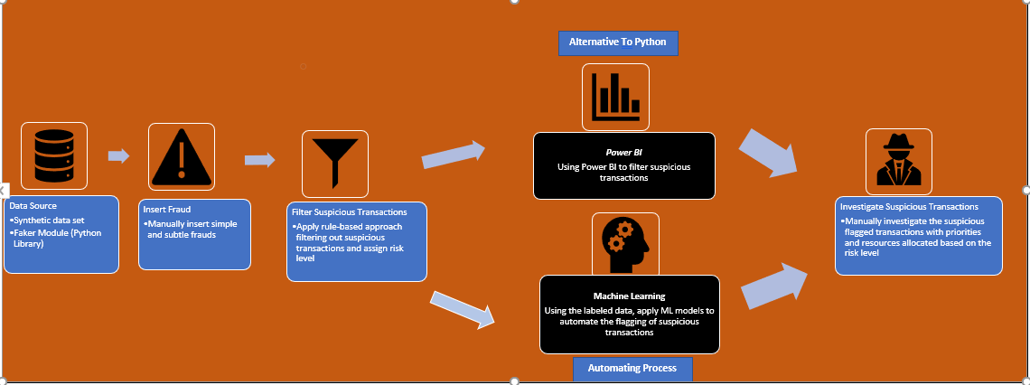
B
Initially project is approach by flagging the transactions using the rule-based approach where as Power BI is template aimed for the business users as alternative to Python.
ML is considered as continuously improving approach where its end goal is to automate the process of flagging the transactions with high accuracy.
A
C
D
F
E
APPROACH
INTRODUCTION
DATA & FRAUD RISK
INSIGHT-I
INSIGHT- II
CONCLUSION

Slide 5
C
A
B
D
F
E
Data Overview
Fraud Types and Risk Level
ID | Fraud Type | Pattern | Potential Implication | Risk level
1 | Duplicate Invoice | Same invoice number, same amount, same vendor name, close timestamp, same employee id | Risk of double payment and submission error by employee | High
2 | Amount Just Below Threshold | Employee splits expenses to stay below approval threshold. | Possible intentional act to bypass the approval policies to hide fraud | Medium
3 | Round Suspicious Amount | Amount values that are rounded and divisible by 50 (900,950,1000,1050) | Possible unrealistic and fabricated figures to hide | Medium
4 | Same Vendor, Many Employees | Single vendor used by multiple employees across unrelated department | Potential collusion, use of ghost vendors or non-compliant procurement procedures | High
5 | Suspicious Keywords in Description | Personal or non-business items in description of transactions | Potential personal misuse or bribery disguised as company expense | High
6 | Late-Night Transactions | Entering expenses during off-hours | Possible attempt to bypass the review or manually overriding transactions | Medium
7 | Approver not in authorization list | Transaction approved by unauthorized personnel | Potential bypass internal control policies and authority matrix, risk of unauthorized transactions | High
8 | Laid off employee making transaction | Laid off employee id recording transaction after offboarding date | Risk of unauthorized access, ghost activity after post exist | High
9 | Vendor with high amount | Vendor that has invoice that has 2.5 time its average amount | Risk of potential error on input data or abnormal procurement | High
Total transactions : 1109
Genuine : 1085
Fraud : 24
Fraud represent 2.16% of total transactions
DATA & FRAUD RISK
INTRODUCTION
APPROACH
INSIGHT-I
INSIGHT- II
CONCLUSION
ID | Fraud Type | Transaction Count
1 | Duplicate Invoice | 6
2 | Amount Just Below Threshold | 2
3 | Round Suspicious Amount | 4
4 | Same vendor, Many Employees | 4
5 | Suspicious Keywords in Description | 3
6 | Late-Night Transactions | 1
7 | Approver not in authorization list | 1
8 | Laid off employee making transaction | 1
9 | Vendor with high amount | 2

Slide 6
A
B
C
F
E
From our rule-based approach out of 1109 transaction 228 transactions were flagged as fraud which represented 20% of total transactions. Actual injected fraud is 24 transactions which is 2.16% meaning there is high false positive rates (Genuine transactions flagged as fraud) which could lead to dissatisfactions and higher time consumption in performing verification check, however, when the cost of fraud is high and risk is significant this is trade-off, flagging the genuine as fraud as to catch all the frauds.
D
Insights From Rule-based Approach
INTRODUCTION
APPROACH
DATA & FRAUD RISK
INSIGHT- II
CONCLUSION
Summary of Fraud transactions
INSIGHT-I
ID | Fraud Type Target | Flagged Count
1 | Duplicate Invoice | 9
2 | Amount Just Below Threshold | 4
3 | Round Suspicious Amount | 5
4 | Same vendor, Many Employees | 211
5 | Suspicious Keywords in Description | 3
6 | Late-Night Transactions | 2
7 | Approver not in authorization list | 1
8 | Laid off employee making transaction | 1
9 | Vendor with high amount | 2
 | Total | 238
ID | Risk level | Transaction Count
1 | Medium | 219
2 | High | 8
3 | Critical | 1
 | Total | 228
Note: Total is 238 in flagged count due to having same transactions meeting multiple fraud criteria, thus there 238 is of not distinct count where as 228 is.

Slide 7
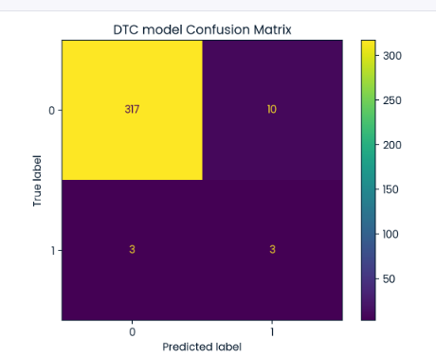
E
A
B
C
D
E
Metric Considered
Insights From Rule-based Approach
Recall : Measure effectiveness in detecting fraud
Precision : Measure the accuracy of the fraud detection
Summary of ML model finding
After testing multiple ML models to automate fraud detection, Decision Tree Classifier performed best. However, due to small dataset size and overlap between fraud and genuine transactions, models often memorized patterns and failed on unseen data. This highlights a key limitation: ML alone cannot fully capture fraud, requiring ongoing human investigation.
INSIGHT- II
INTRODUCTION
APPROACH
DATA & FRAUD RISK
INSIGHT-I
CONCLUSION

Slide 8
A
B
C
D
E
Conclusion
F
Rule-Based Approach
Captures all fraud but flags many genuine transactions as fraud.
Synthetic dataset inefficiencies reduce reliability.
Real-world data expected to give more practical, resource-efficient results.
Machine Learning Approach
Current best: Decision Tree with 50% recall and 23% precision.
Struggles with frauds similar to genuine transactions.
Needs larger labeled real-world data and richer features.
Further experiments with complex models could improve accuracy.
INTRODUCTION
APPROACH
DATA & FRAUD RISK
INSIGHT-I
INSIGHT- II
CONCLUSION

Slide 9
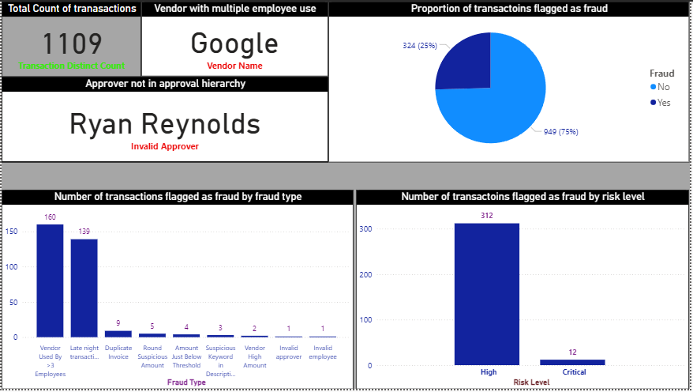
Alternative to Python Rule-Based Approach
Using M language in Power BI, created a template for business user that would allow users to copy and paste the transactions that would create a summary of visualization as well as allow user to extract the summary report on the flagged transactions.

